Slide 1
Chapter 9
Process Modeling – Part 1

Slide 2
System Modeling Terminology
Model
  a pictorial representation of reality
Logical Model
  a non-technical representation that depicts what a system is or does that is technology independent
Physical Model
  a technical representation that depicts not only what a system is or does, but also how it does it, that is technology dependent

Slide 3
cont’d
Process Modeling
a technique used to organize and document a system’s processes showing data flow, logic, policies, and procedures
Data Flow Diagram (DFD)
a process model used to depict the flow of data through a system and the processing performed by the system.

Slide 4
cont’d
Process
  work performed by a system in response to incoming data flows or conditions
Decomposition
  the act of breaking a system into sub-components of functions, activities and tasks
Function
  a set of related and ongoing activities

Slide 5
cont’d
Event
  a logical unit of work that must be completed as a whole. Also known as a transaction.
Elementary Process
  a discrete, detailed activity or task required to complete the response to an event. Also called a primitive process.

Slide 6
Data Flow Diagrams
External Agents
Data Stores
Process
Data Flows

Slide 7
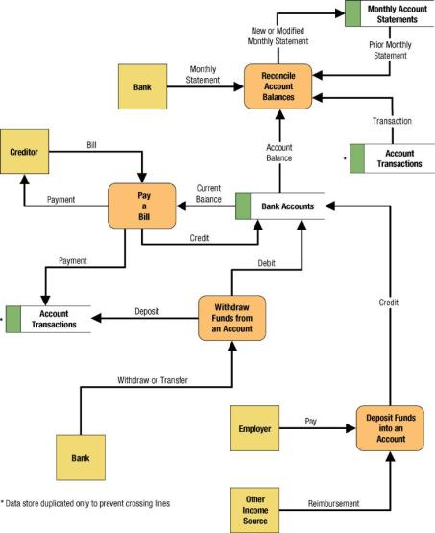
Example DFD
Process
Data Flows
External Agents
Data Stores

Slide 8

External Agents
External Agent
  a person, department, system, or organization, outside the scope of the project, that interacts with the system
  provides net inputs from the system, receives net outputs from the system, or both

Slide 9

Data Stores
Files
Databases
one data store for each data entity on an ERD
… data at rest

Slide 10
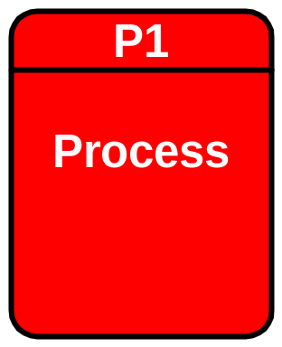
Process
Work performed by a system in response to incoming data flows or conditions and transform data into useful information
All information systems include processes

Slide 11
Data Flows
Data Flow
Composite Data Flow
Control Flow
Logical Data Flow
Divergent and Convergent Data Flows
… data in motion
Data flow name

Slide 12
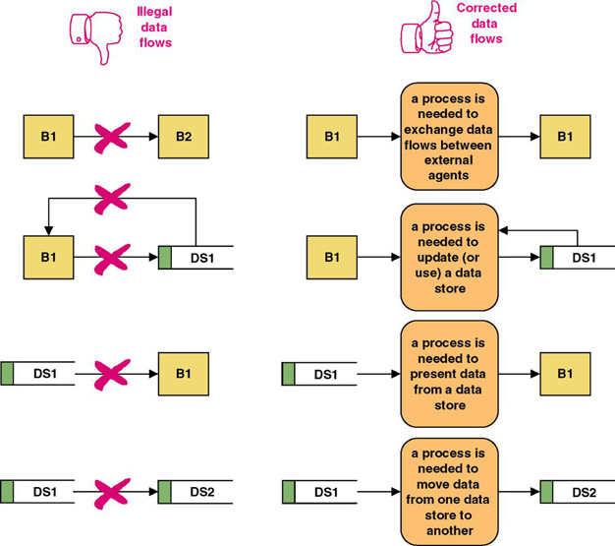
Data Flow Errors

Slide 13
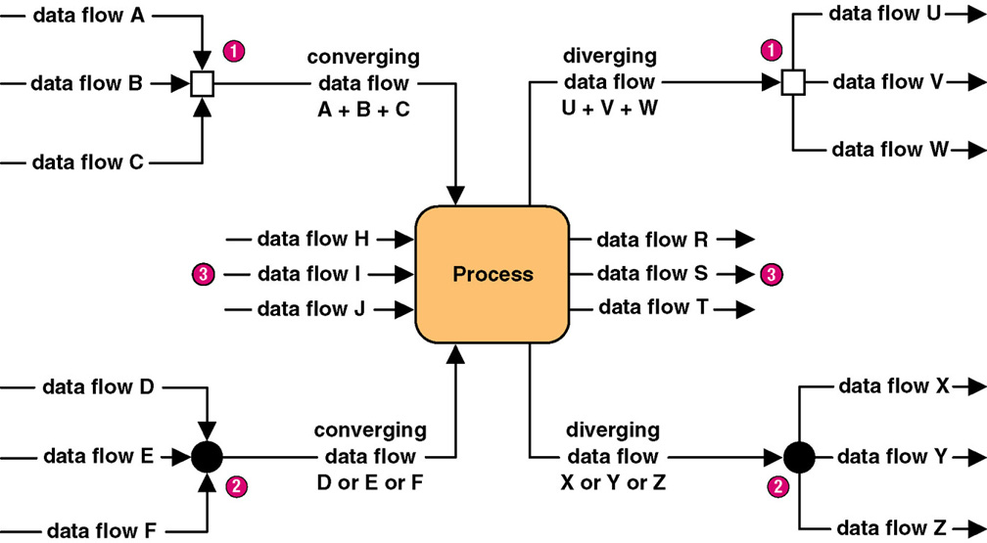
Diverging and Converging Data Flows

Slide 14
End of Part 1

